Slide 1

Deepfake Detection Challenge
Purpose: to find innovative new ways to identify deepfakes and altered media.
Participants are given sets of videos:
Labels: Real, Fake.
Powered by:
AWS.
Facebook.
Microsoft.
Partnership on AI’s Media Integrity Steering Committee.
Members of Academia.
Exploring code by user Jianing Sun.
https://www.kaggle.com/jianingsunjs4770
https://www.kaggle.com/jianingsunjs4770/deepfake-based-on-image-noise-pattern
Code built in TensorFlow.
https://www.kaggle.com/c/deepfake-detection-challenge/overview/description

Slide 2

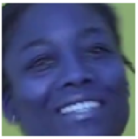
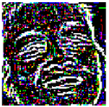
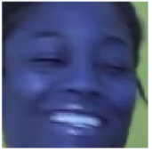
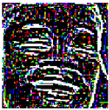
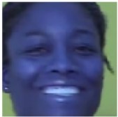
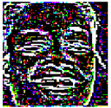
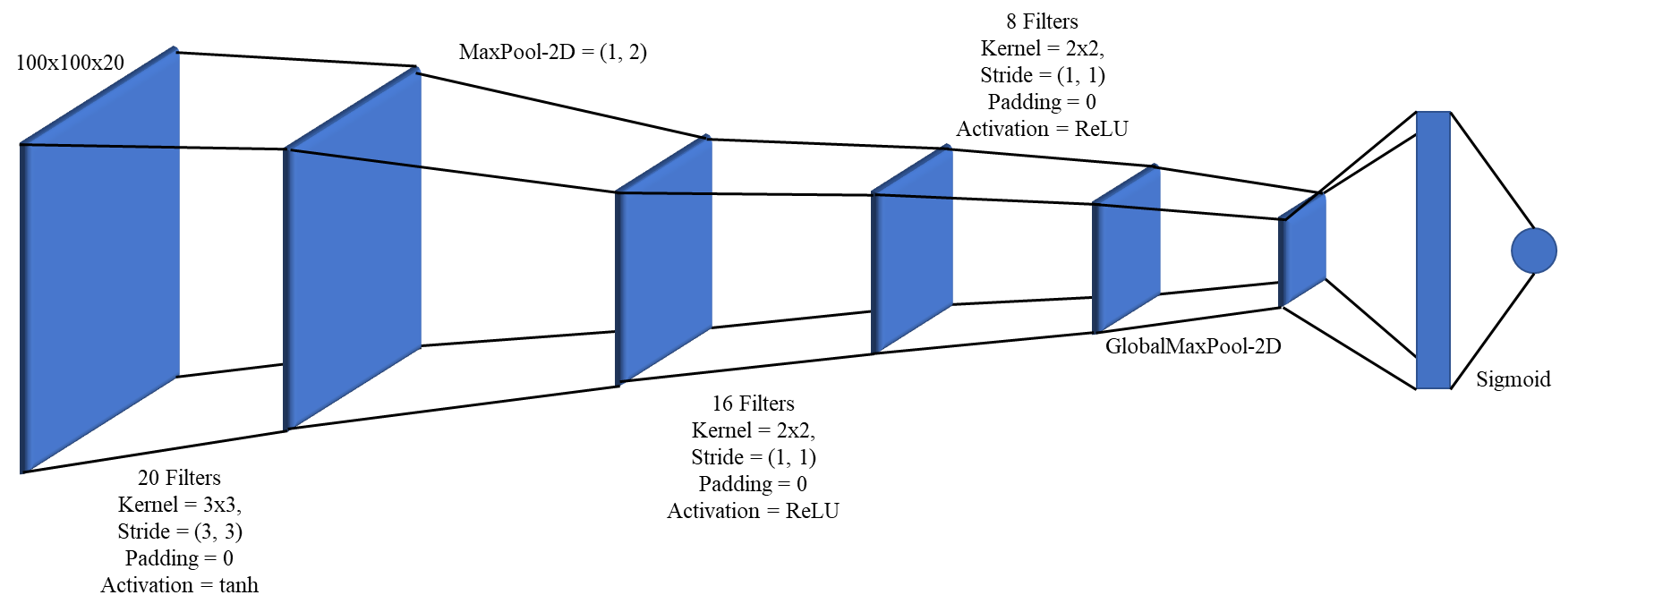
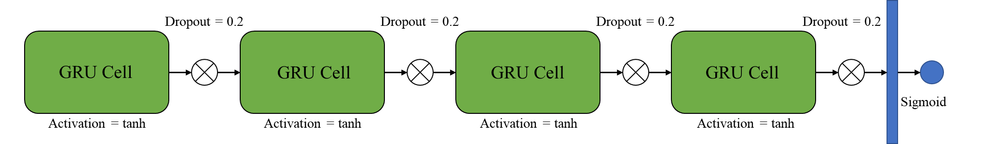
20 Video Frames
20 Noise Frames
Drop videos with no faces
Import Data
Gaussian Blur
Face Crop, Resize
Diff(Original, Blur)
Frame: 100x100x3
Frame: 100x100x1
20 Epochs
10 iters / epoch
Real/Fake
CNN
Threshold
SGD
Learning Rate = 0.01
Momentum = 0.9
Loss = BCE
Metric = Accuracy
Threshold
Real/Fake
GRU
Train/Test Split
Upsample real videos 4 times
50 Epochs
Batch Size = 16

Slide 3

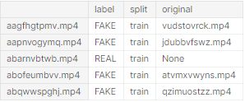
The Data
471.84 GB of video
Not publicly available
Metadata json file.
Filename
Video file name.
Label
Real or Fake.
Original
If Fake, name of source/original video.
Split
Always train.
Code of interest uses a sample of the full data.
400 training videos
400 testing videos

Slide 4

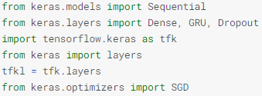
Code
Imports a Haar Feature-Based Cascade Classifier.
Frontal Face Detector.
Basic TensorFlow/Keras libraries.
Pytorch equivalent

Slide 5
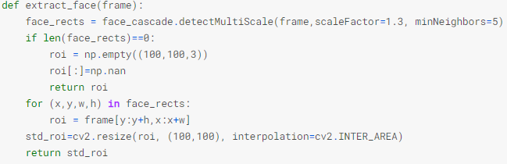
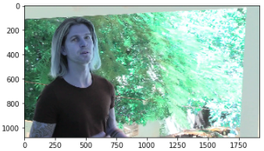
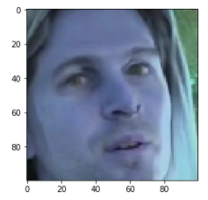
Face Detection & Standardization
Input: Video frame
Returns rectangle where face is located
If no face was detected in the frame
Create an empty picture of size 100x100x3
Fill it with NaN.
Return it. End Function
For each rectangle in the frame
Crop the frame to the face
Resize crop to 100x100x3
Return standardized face image

Slide 6
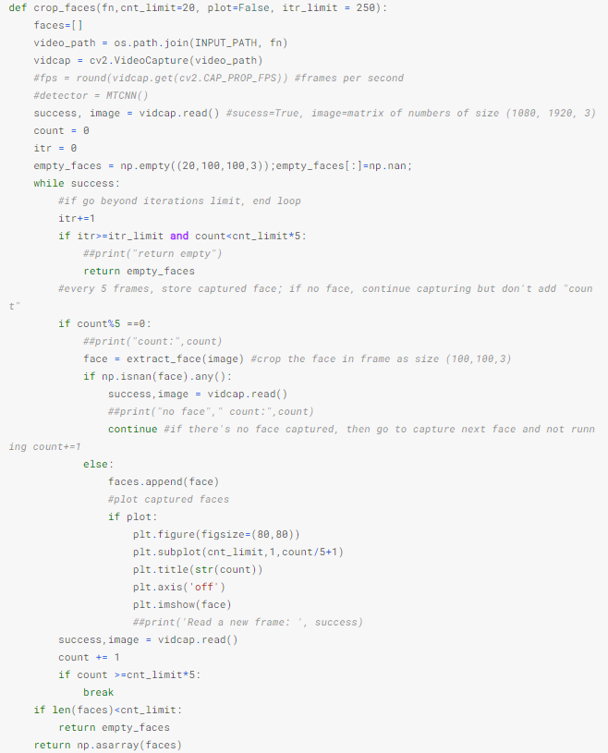
Cropping Faces
Input: File Name. cnt_limit = Limit on number of frames to return. itr_limit = number of frames to process.
Create list to hold faces
Path to video file + video file name
Create VideoCapture object.
Read in video
Create count & iteration variable
Create an empty face array of size 20x100x100x3
While video read is successful
If have processed itr_limit frames and have not found enough faces, return count_limit empty faces.
For every 5th frame
Extract cropped face (function in previous slide)
If no face detected, move on. Do not increase count.
If a face is detected
Add face to faces list
If plot is true, plot frame
Move to next frame, increase count
Once reach count limit, break while loop
If the number of faces processed is less than the amount wanted, return empty faces
Else, return faces list as array

Slide 7
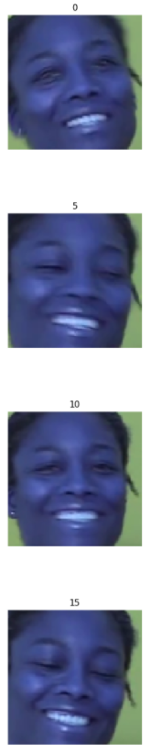
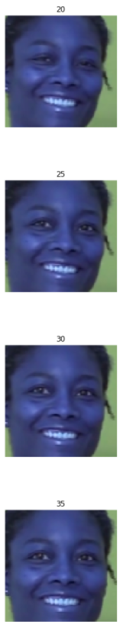
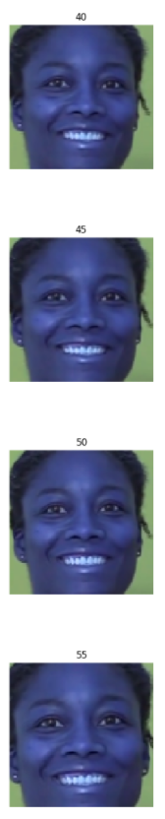
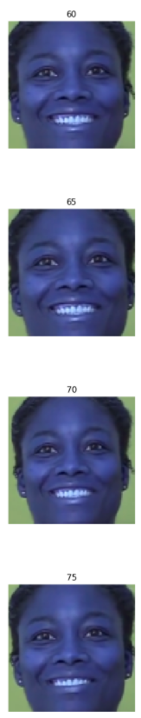
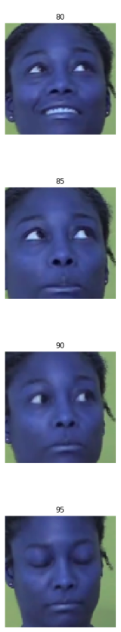
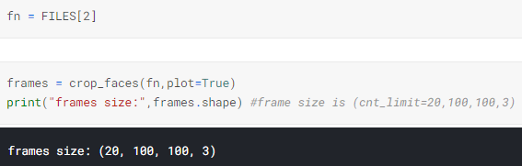
Cropping Faces Example

Slide 8
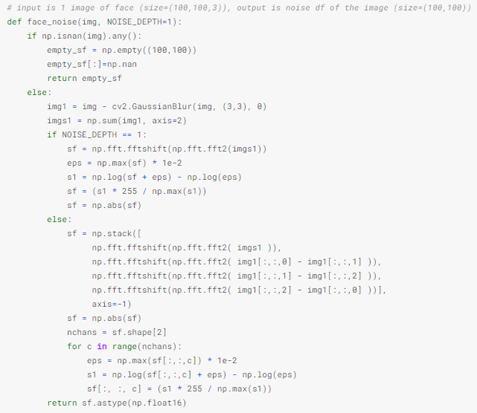
Gaussian Noise
Input: image frame
If the image is empty, return empty
Apply gaussian blur and take difference with original image
Sum across channels. New Shape: 100x100
Compute 2D Discrete Fourier Transform, then shits the zero-frequency component to the center of the spectrum
Calculate ε
Extra math
But why???
This part was not used

Slide 9
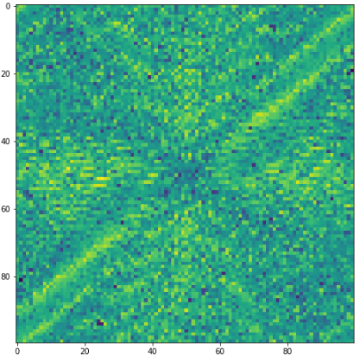
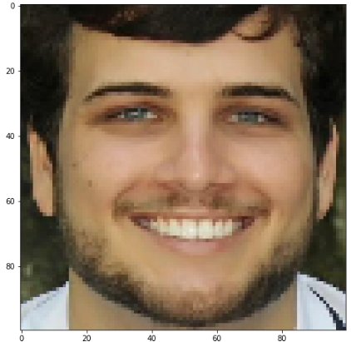
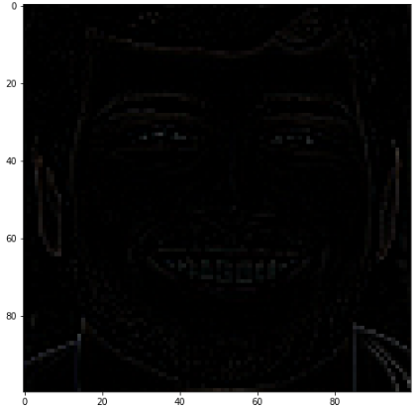
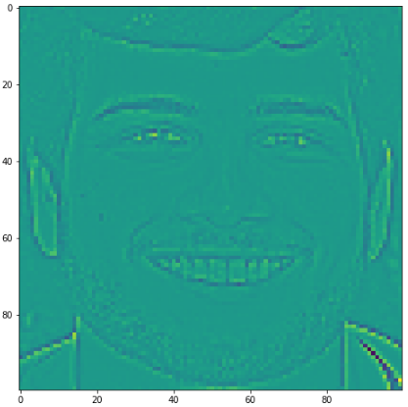
face_noise example

Slide 10
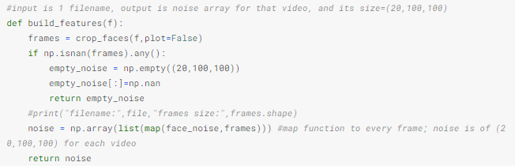
Build Features
Input: file name
Apply crop faces.
If any frame have NA in them
Return 20 100x100 frames of NAs
Apply noise transformations to the 20 frames
Return noised frames of shape 20x100x100

Slide 11
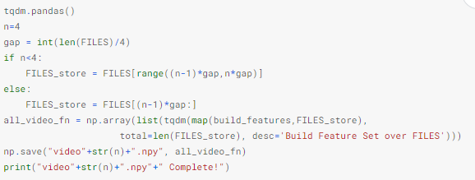
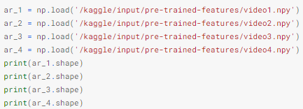

Apply Various Functions to Data
Note: This code is run 4 times.
Isn’t displayed on Kaggle.
This code should be in a for loop
Remember: FILES contains file names of training data.
Training Data has 400 videos
This code reads in files 100 at a time and applies build_features.
build_features extracts 20 frames from videos and applies noise transformations. Some videos returned will be 20 100x100 frames of NAs
Not an actual video. A numpy array containing 100 observations
Each video contains 20 frames
100 Video observations
Each frame is 100x100

Slide 12
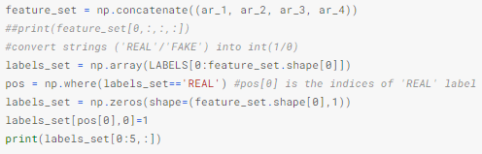

Create Labels
Combine processed videos. feature_set size = 400x20x100x100
Grab labels in an array.
Identify positions where label is REAL
Create an array of zeros, one for each observation. 0 = FAKE
Replace observations with 1 at REAL positions

Slide 13
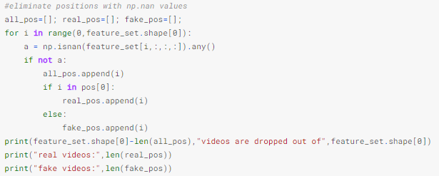


Filter Out NA Videos
Create lists to hold positions of all, real, and fake
For each observation
Identify if any NAs exist (Any empty frames)
If there are no empty frames in observations
Add position
If observation is REAL, add to real positions
Else, it is FAKE. Add to fake positions
Shuffle the real and fake positions

Slide 14
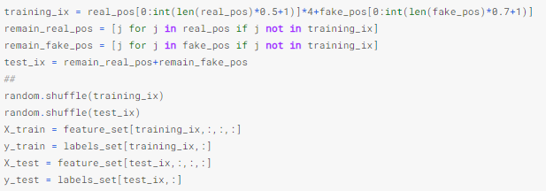
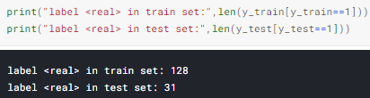
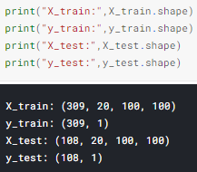
UpSampling & Train/Test Split
To balance labels, up-sample real videos 4 times
Create training data indexes. For real labels, take the first few positions 4 times. For fake labels, take a larger portion of the first few positions.
Use the positions that were not selected as test data indexes.
Shuffle the training and test indexes
Grab the corresponding index positions from the feature_set and the labels_set

Slide 15

Create Dataset Object for TensorFlow

Slide 16
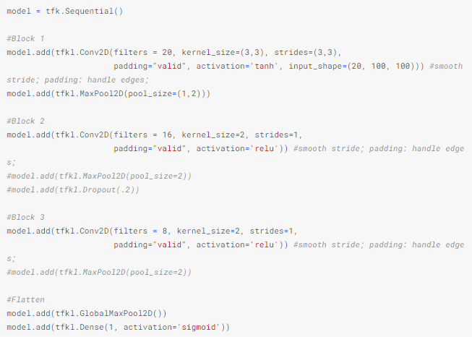

Build & Fit 3D CNN

Slide 17
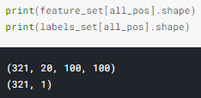
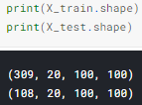
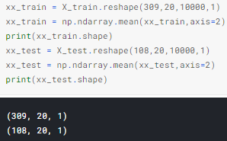
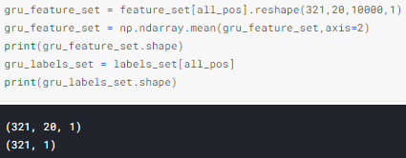
Prep Features for GRU
Flatten frames
Take mean of each flattened frame
Flatten frames
Take mean of each flattened frame

Slide 18
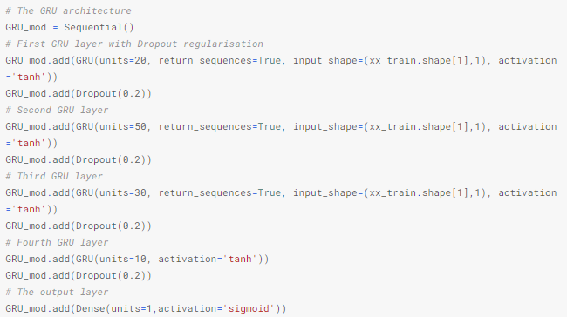


Build & Fit GRU

Slide 19
This Code is Incomplete
Leaves room for improvements!

